Slide 1


GoldenAuctions
Laboratory of Advanced Programming
Federico Ambrogio 1810535
Luigi Buccigrossi
1793929
Francesco Fè 1814878
a.y. 2023/2024
Angelo Casciani - 2022406
Marco De Luca - 2017104
1

Slide 2
Brief presentation
GoldenAuctions is a web platform through which users can take part in an auction or create one of their own.
The customers should be able to:
Access to main page, in which trending auctions are available.
Search for a specific auction.
Participate to an auction.
Create their own auction.
Register and access with its credentials.
Access to the page containing their active auctions.
Update their credentials.
Get a notification at the end of an auction.
Access the profile page of users

Slide 3
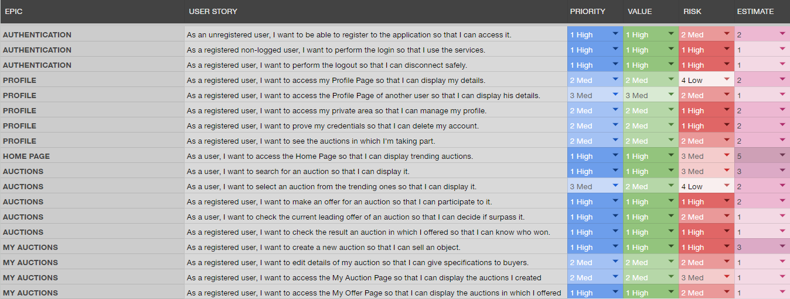
User stories

Slide 4
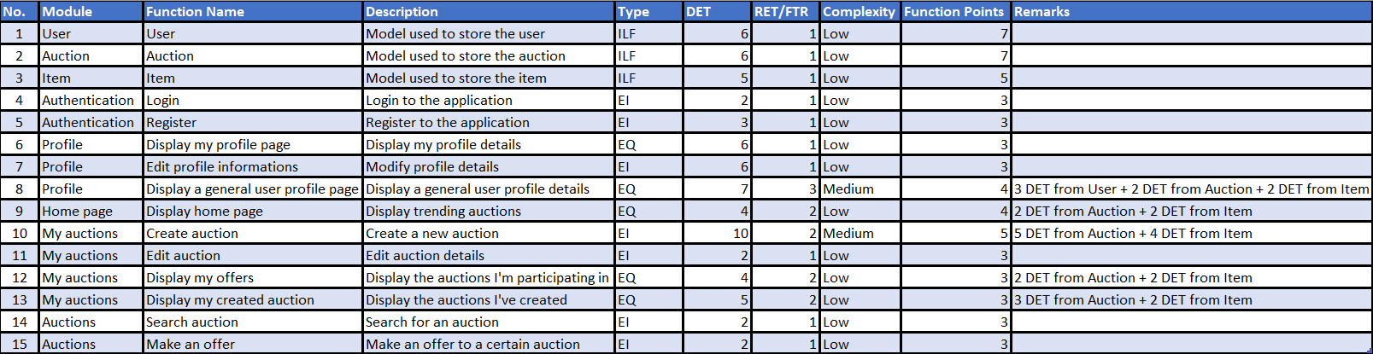
Function points
Function Points = 59
Estimated SLOC = 3127

Slide 5
Function points

